Slide 1
Presenting science:
Tips & tricks for acing your talk or poster
Intro & Outline
Slide rules
Fonts
Graphs
Backgrounds
PPT alternatives
Top- / bottom bars
Animations
Mental preparation

Slide 2
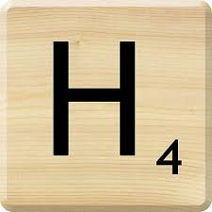
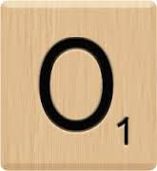
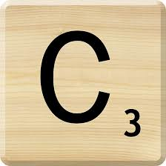
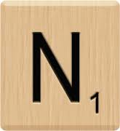
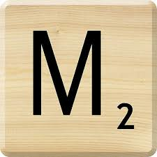
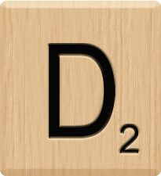
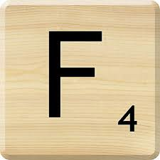
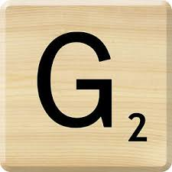
Combined Effects of Ocean Acidification and its Co-stressors On Marine Organisms
Hannes Baumann
Department of Marine Sciences
University of Connecticut
hannes.baumann@uconn.edu
www.befel.marinesciences.uconn.edu

Slide 3
Combined effects of low pH and low O₂ on coastal organisms
H. Baumann, E. Smith, C. Gobler
Sometimes …
1 + 1 > 2
Flax Pond Salt Marsh, Old Field, NY

Slide 4
Outline
Introduction
Material & Methods
Results
Discussion

Slide 5
Outline
Ocean acidification: the other CO₂ problem
Experimental setup
Reaction norms of larval fish exposed to CO₂
Fish in an acidified ocean

Slide 6
Scientific story telling
Intrigue the audience by providing a narrative
Instead of
And … and … and … (AAA)
Try
And … but … therefore … (ABT)
Observation
Problem
What did you do about it?
https://www.huffingtonpost.com/steven-newton/and-but-therefore-randy-o_b_8813330.html
http://www.laseagrant.org/wp-content/uploads/LaDIA-Katrina-blog-AC.pdf

Slide 7
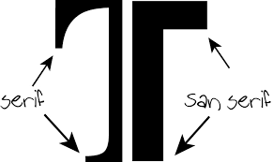
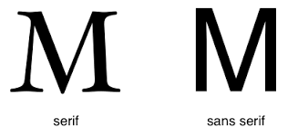
Fonts
These are examples of Serif fonts → nice in a book, not good in a presentation
Times New Roman, Lucida, Palatino, Adobe Caslon … absolutely not!

Slide 8
Good sans serif fonts
Arial Black
Verdana Bold
Futura
Berlin Sans
Helvetica
Comic Sans

Slide 9
Font sizes (36)
Header (40)
Header 2 (32)
This is a bullet point in 28
This is a bullet point in 24
This is a bullet point in 20
This is a bullet point in 18
This is a text in font size 12. Standard for documents, too small for presentations

Slide 10
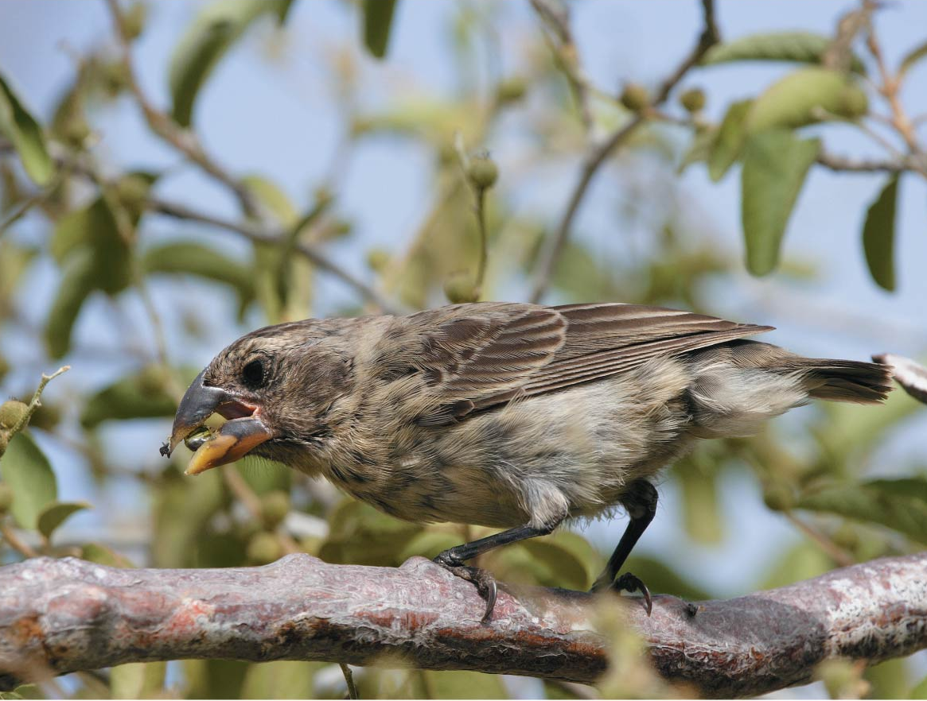
Evolution of populations
Individuals do NOT evolve
Chapter 23

Slide 11
Evolution of populations
Individuals do NOT evolve
Outer glow is very effective
Shadowing not so much
Chapter 23

Slide 12
Backgrounds
Contrast is key !

Slide 13
Backgrounds
Contrast is key !

Slide 14
Backgrounds
Backgrounds
Contrast is key !
Contrast is key !

Slide 15
Pictures of landscapes will often work well …
… if there’s not too much structure and
you chose the right contrast

Slide 16
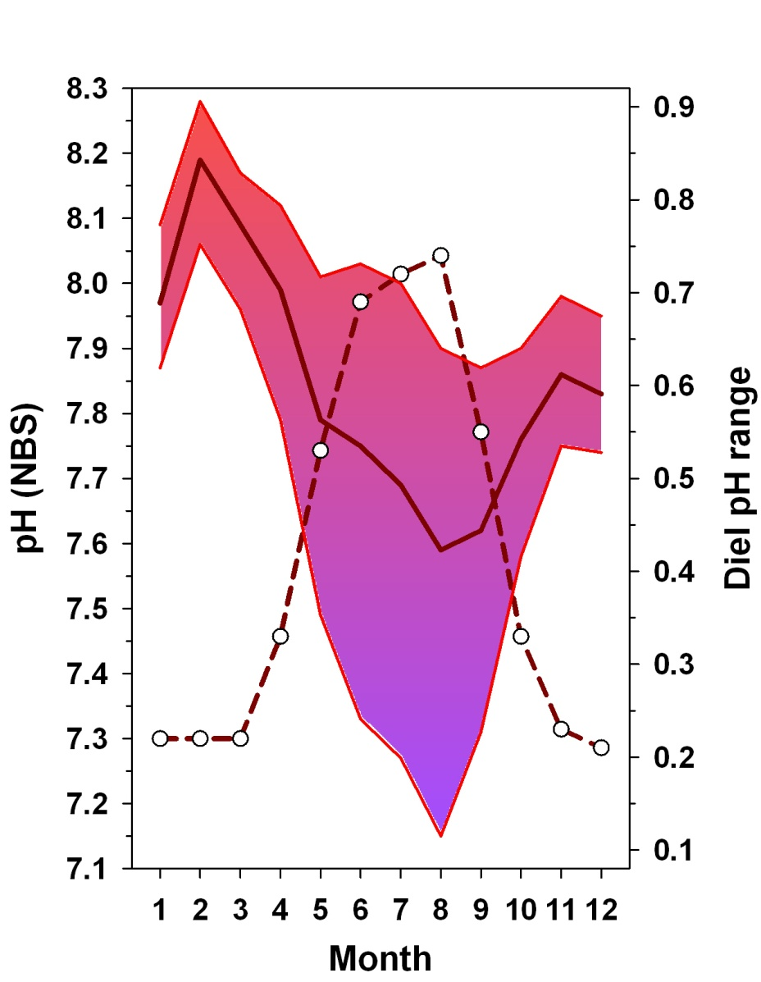
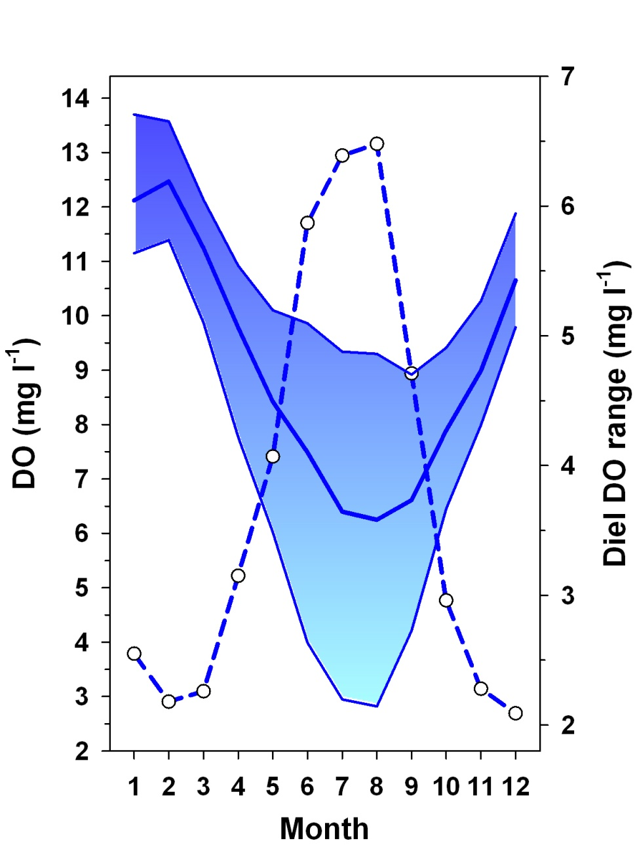
Fading the background picture to increase contrast

Slide 17
Hannes Baumann, R. Wells, J. Rooker, Z. Baumann, D. Madigan,
O. Snodgrass, H. Dewar, and N. Fisher
Combining otolith microstructure + microchemistry
What can we learn about juvenile Pacific Bluefin Tuna migration ?

Slide 18
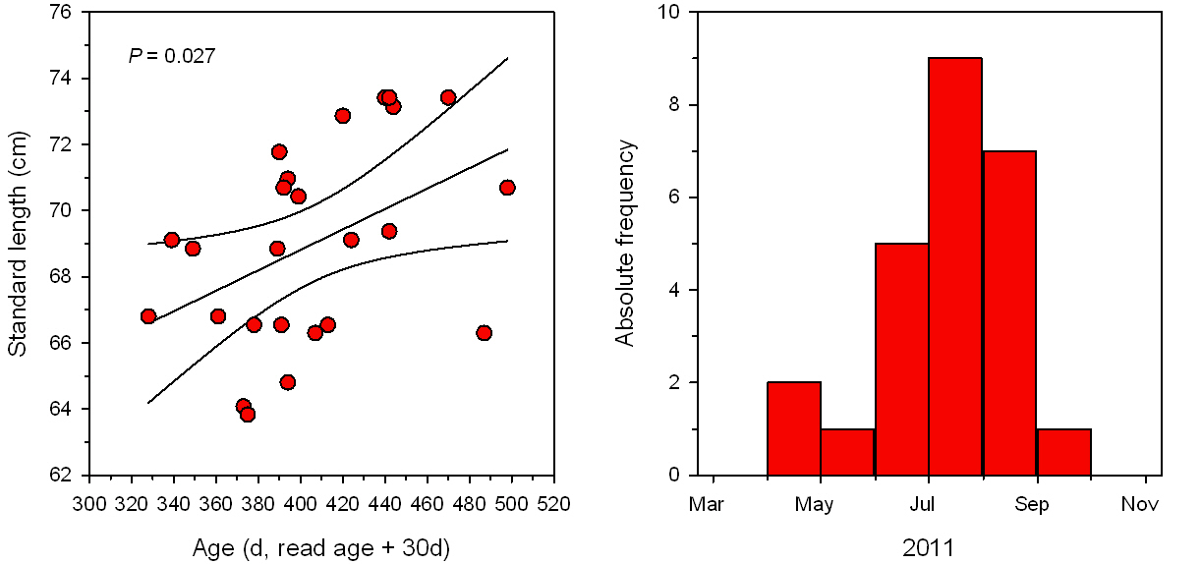

Slide 19
Slide organization
Top-, Bottom-, sidebars

Slide 20
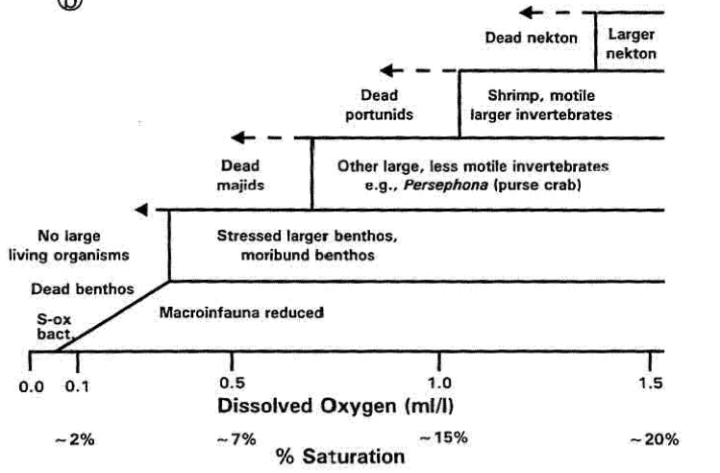
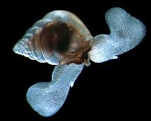
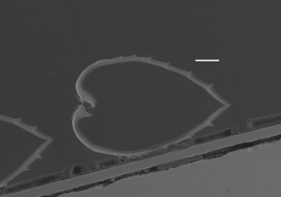
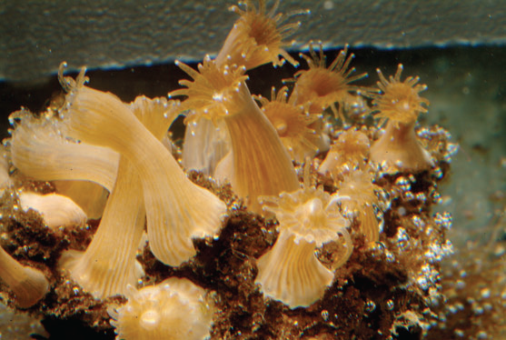
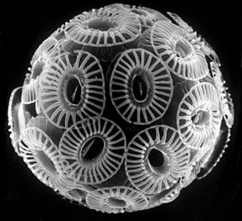
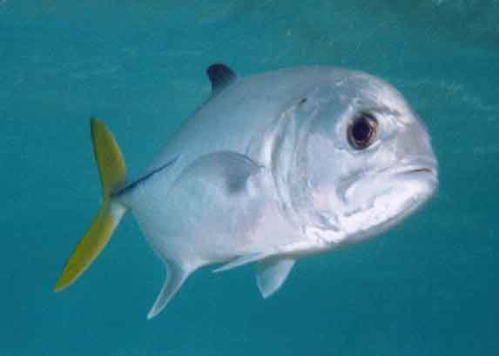
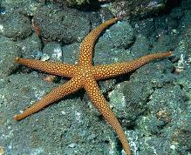
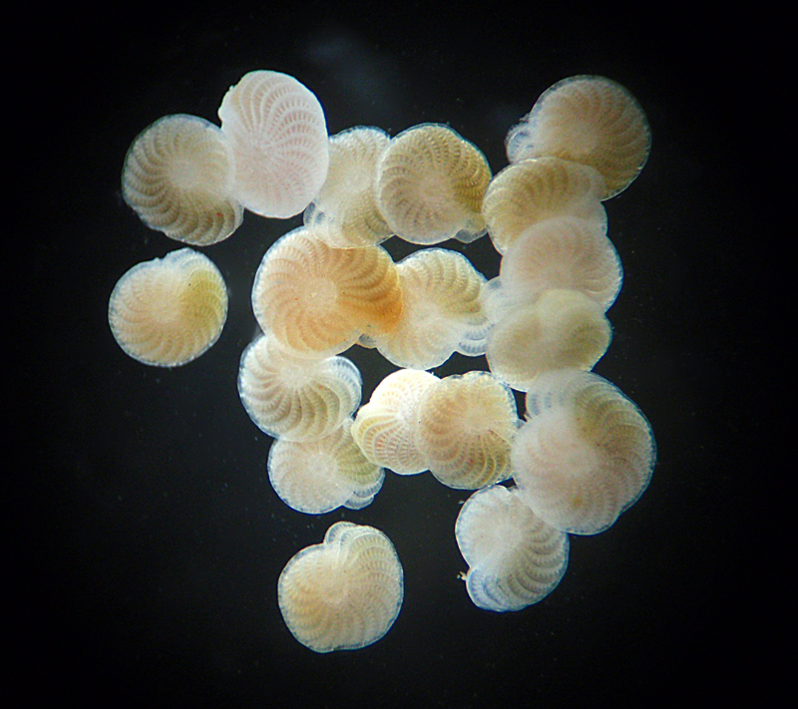
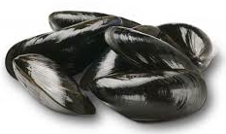
Large body of research:
Hypoxia & acidification affect organisms
Diaz & Rosenberg 1995
ACIDIFICATION
HYPOXIA

Slide 21
Combined Effects of Ocean Acidification and its Co-stressors On Marine Organisms
Bottom bars to repeat information or count slide numbers

Slide 22
Side bars
Pretty, but too much lost ‘real estate’

Slide 23
Side bars
Better, but you still want to ‘use’ the blocked space

Slide 24
Animations
~90% of the ppt options are inappropriate for a science talk

Slide 25
Text animations are also a no-no
Text animations are also a no-no
Text animations are also a no-no
Bullet points should just appear, …
so you can make each point and …
have the attention of the audience

Slide 26
The pattern holds for other Pomacentrids
Settlers
Settlers
Depth-dependent growth
Temperature-dependent growth
Pre-settlers
Pre-settlers
Otolith-fish size relationship
Chrysiptera rollandi, Lizard Island 2007
(Baumann unpubl data)
Pomacentrus amboinensis, Lizard Island 2005
(Gagliano unpubl data)

Slide 27
Juvenile growth in the laboratory
Juvenile growth in the laboratory
Field
Laboratory
Declining but still relatively
high growth in recruits
Declining but still relatively
high growth in recruits
Ad libitum
group showed
partial growth
compensation
Ad libitum
group showed
partial growth
compensation
Field →
Laboratory
Growth declined
further in
starving group
Growth declined
further in
starving group
Experiment

Slide 28
Selective mortality!
?
Juveniles caught!
18.-23.10.

Slide 29
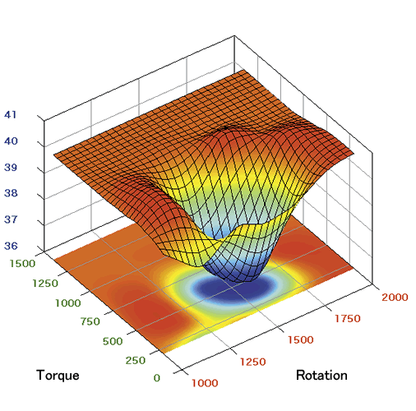
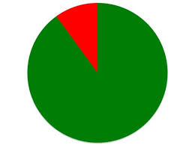
Graphs
= arguably the main reason for using ppt etc in the first place

Slide 30
Graph rules
1. A graph should only contain information/data you actually talk about
N-America: Atlantic
Europe: Atlantic
Asia: Pacific
Latitude (°N)
Week of the year
“ … but today I’m only going to talk about the first panel …”

Slide 31
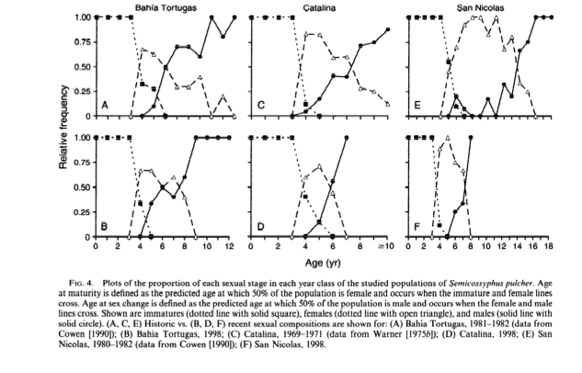
Graph rules
2. Thou shalt not copy and paste graphs from papers (not even your own)

Slide 32
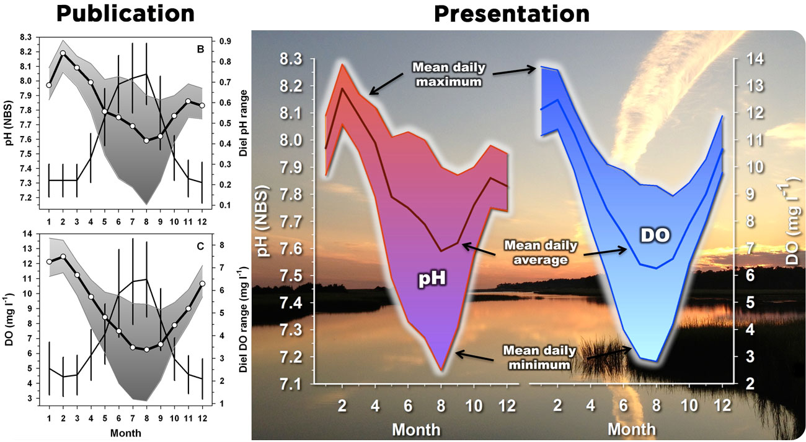
In a publication (left side), the focus is on clarity, simplicity, and the use of colors is often constrained. But for a presentation the graphs are best reworked to direct the audience’s attention. Here, the background sets the stage for the study habitat, the graphs are combined, colored and annotated.
In a presentation, nobody can read a figure caption!

Slide 33
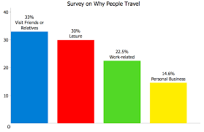
Graph rules
3. Know the complexity of your graph – adjust your presentation accordingly
1st order graphs
Simple pie, regression, or bar graphs
(You can simply state the message)

Slide 34
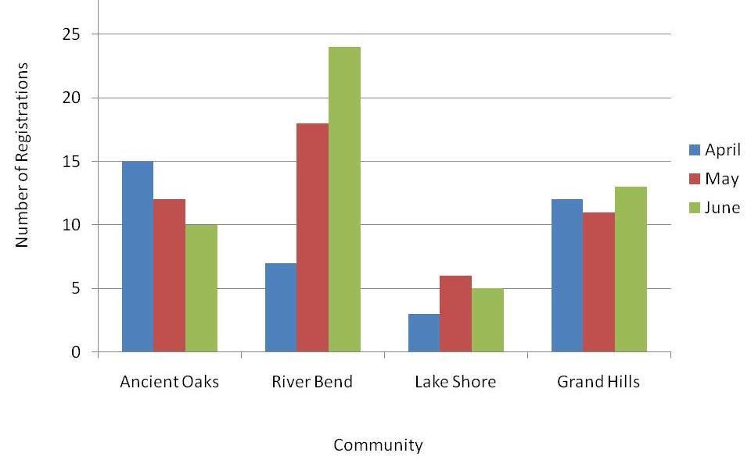
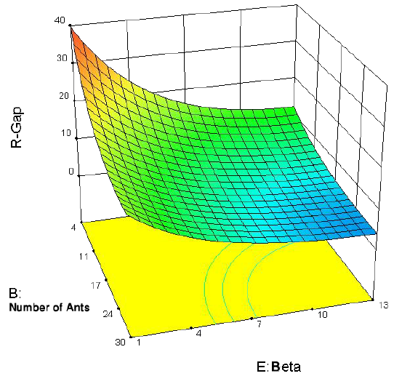
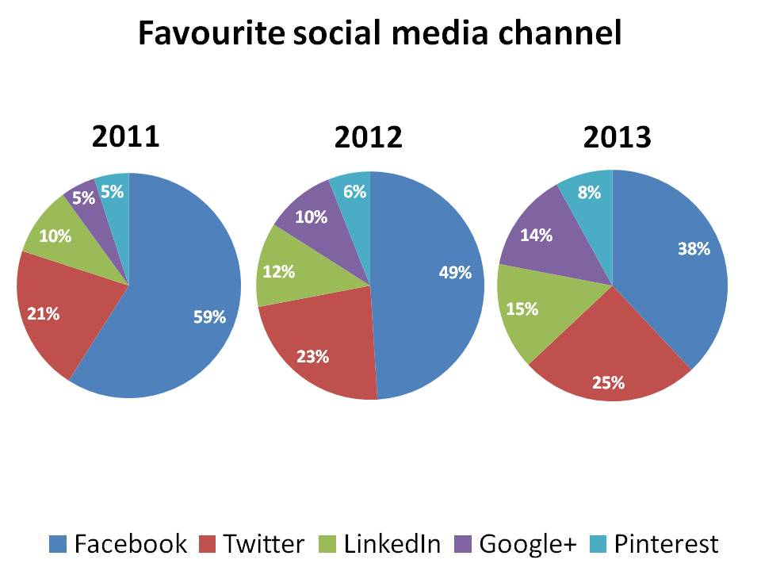
2nd order graphs
Nested bar graphs
Multiple panels of 1st order graphs
Multi-category pies
Multiple regression or other line graphs
Simple 3D (e.g. surface plots)
control
treatment
Guide the eye of the audience by connecting the colors/labels of your graph to your message step by step

Slide 35
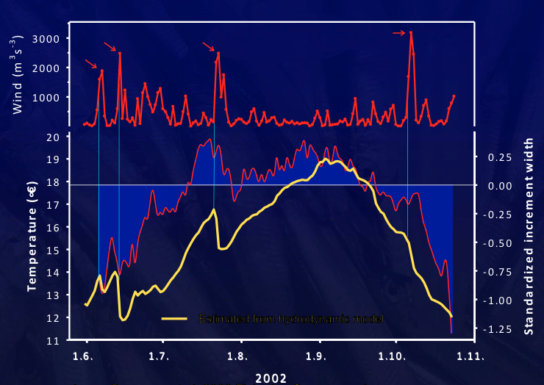
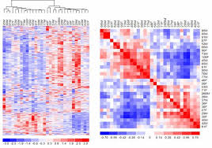
3rd order graphs
Multiple panels of 2nd order graphs
Multiple line, time series graphs
Correlation matrices
Advanced 3D
Contour plots
Tell the audience what pattern you want them to look at exactly, e.g., “ the fact that the green is getting successively less over time …”

Slide 36
Graph rules
4. Complexity also increases with the kind of unit depicted
1st order units:
Length, weight, temperature, distance, time …
2nd order units:
Rates (e.g., growth), residuals, anomalies
3rd order units:
Ratios (e.g., Sr:Ba), derived statistics (plot of P- or R²-values), replace with indices?

Slide 37
Graph rules
Always introduce axes labels
Font rules apply to tick and axes labels, too!
Have a few extra slides/graphs for questions ready

Slide 38
Use consistent, contrasting colors
Use consistent, contrasting colors
Use consistent, contrasting colors
Use consistent, contrasting colors

Slide 39
Acknowledgements
Be brief, stick to collaborators, funders
Your co-authors don’t need to be thanked
Neither do your parents, friends or lab mates

Slide 40
Check spelling!
“1 min / slide” rule
“1 min faster than rehearsed” rule

Slide 41
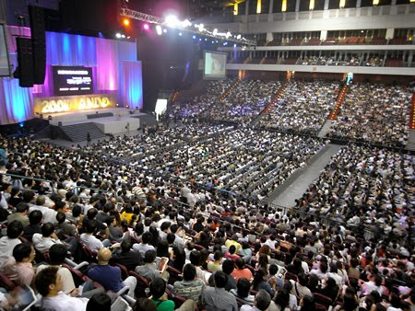
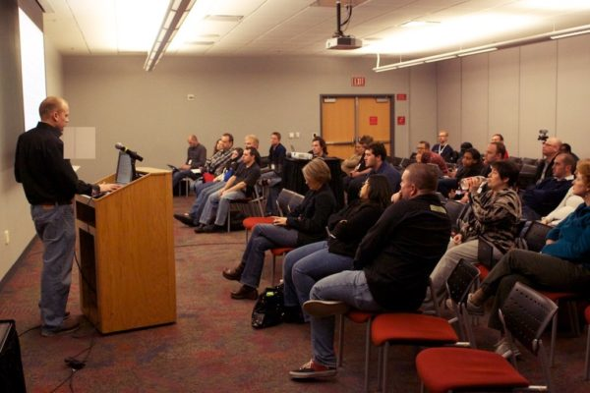
Mental preparation II:
Relax.
More like this …
It’s NOT going to look like this

Slide 42
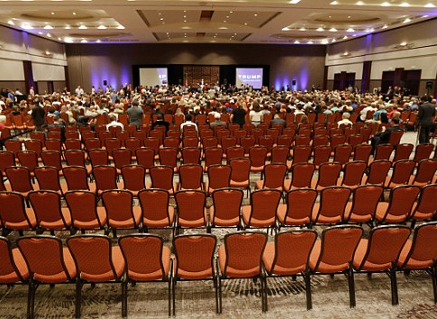
Mental preparation III
Have your talk uploaded the day before
Attend the whole session (don’t just skip in for your talk)
Try to make a reference to some earlier presentation
Don’t worry about the bit of adrenalin. It’s normal.
Know your first sentences

Slide 43
After the talk
Stick around, your job isn’t done.
Be grateful for compliments, but don’t make too much of them

Slide 44
Powerpoint alternatives, e.g. Prezi
Try it for stand alone talks
unpractical for large meetings, e.g., OSM

Slide 45
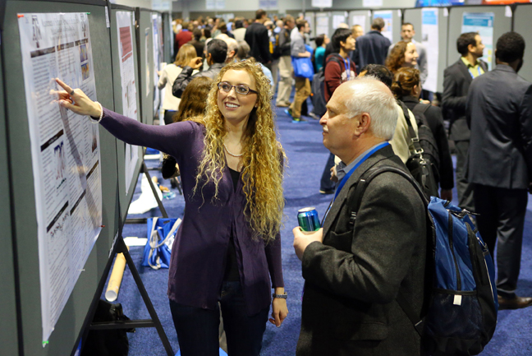
Generally, the same rules apply
Title, authors, affiliations, picture (?)
The less text, the better (e.g. bullet point abstract)
One central figure, photo to catch the eye
Your poster belongs to a session, get to know the people in your session, mention your poster
Small poster printouts for people to take
Posters

